Slide 1
Stock Market Analysis using Python
A Beginner-Friendly Exploration with Bajaj Stocks
By: Suraj Pradhan

Slide 2
Objective and DatasetContent:
Objective: Analyze stock data of Bajaj Auto, Bajaj Finserv, and Bajaj Finance to derive investment insights.
Dataset: Historical stock data (CSV) including Open, Close, Volume, Date, etc.
Time Frame: From 2000 to 2021 (varies slightly by stock)

Slide 3
Preprocessing and Feature EngineeringContent:
Handled null and duplicate values
Converted Date column to datetime format
Dropped unused columns (Trades, Deliverable Volume, %Deliverble)
Added new features: Day, Month, Year

Slide 4
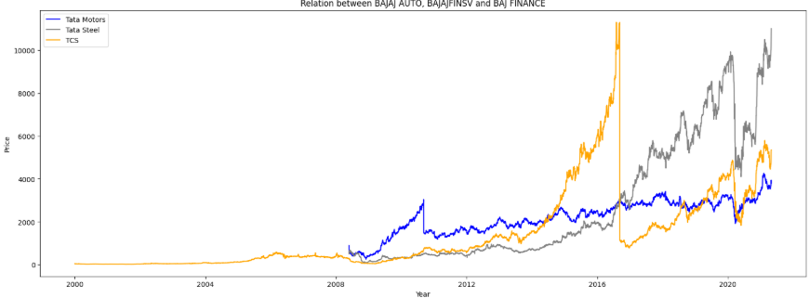
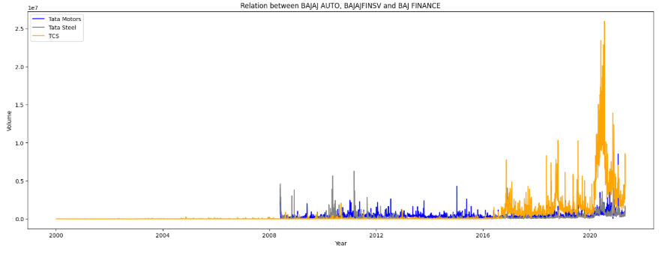
Price & Volume TrendsContent:
Line plots showing trends in stock prices
Line plots showing trends in trading volume over time

Slide 5
Return on Investment (ROI)Content:
Calculated ROI as:
Bajaj Auto: -86.46 %
Bajaj Finserv: -62.38 %
Bajaj Finance: 111.76 %

Slide 6
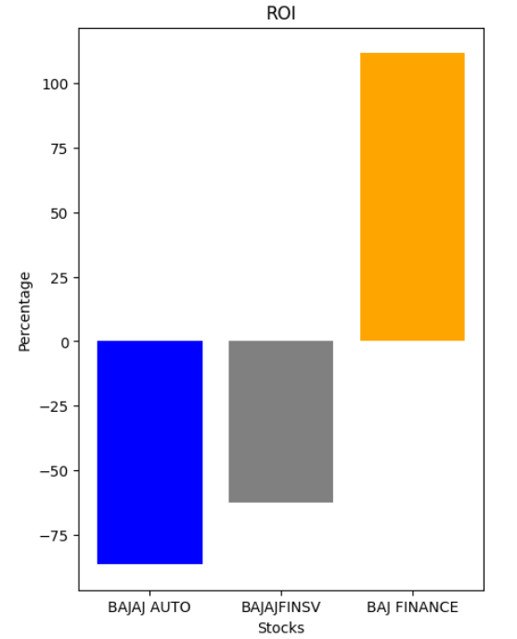
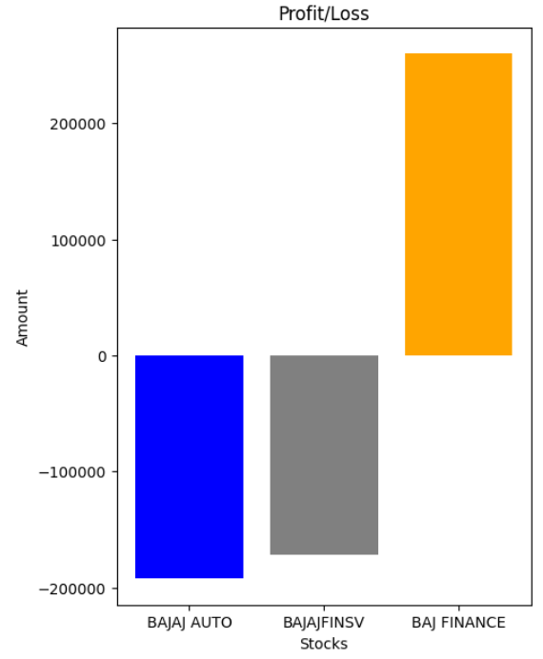

Slide 7
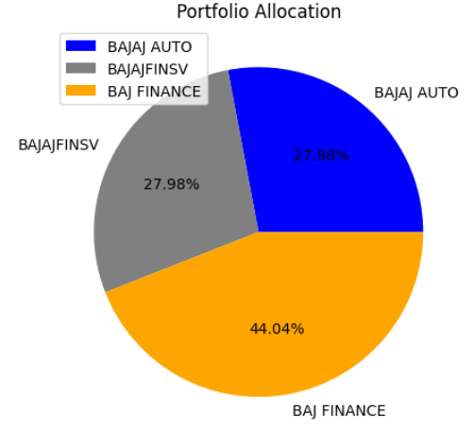
Portfolio Allocation & SummaryContent:
Shares owned in each stock visualized using a pie chart
Key takeaways:
Bajaj Finance gave highest ROI
Balanced portfolio improves returns

Slide 8


